Slide 1

Shree Shambhubhai V. Patel College Of Computer Science And Business Management Online Job Portal Subject: 501-01 (Advanced web Designing) OF T.Y.B.C.A. (Sem-5)
Submitted By : Guided By:
Gola Jinal Shaileshbhai Asst. Prof. BipinJadav
Roll No.51
Exam No :3840

Slide 2
Contents
1. Introduction
2. Objectives
3. System Flow Chart
4. DFD/ UML Diagram
5. ER Diagram
6. System Design
7. references

Slide 3
1. Introduction
An Online Job Portal System Can Be Defined As Software That Allows Jobseeker To Apply Jobs & Manage Their Profile.
Online Job Portal System Generally Consists Of 3 Main Components.
1. Jobseeker - First Is a Jobseeker which apply the job.
2. Job Provider (Company) - Second Is Job Provider which is Post Jobs and it will displayed to Jobseeker.
3. Admin - Third Is An Admin Management Interface For The JobPoratal , Jobseeker and Job Provider.

Slide 4
Project Profile
Project Title : | JobDekho
Project type : | Website
Front-End : | HTML5 , CSS , JavaScript , Bootstrap
Back-End : | PHP , MySql
Web Server : | XAMPP- Cross Platform, Apache, MySql, PHP
Operating System : | Windows 11
Internal Guide : | Asst. Prof. Bipin Jadav
Submitted To : | Shree Shambhubhai V. Patel College of Computer Science and Business Management
Submitted By : | Ms. Jinal Gola

Slide 5
2. Objectives of Project
The Main Objective Of Job Portal System Is To Manage The Jobseeker (Employee) And Company (Employer) Registration ,Search Job And Details Of Their Jobs.
It Manage All Information About Post A Specific Job And You Can Search
The Specific Job.
Provide A Platform For Company ( Employer) To Post Job Listing.
Connect The Employees With Suitable Opportunity.
Our Main Motive Is Provide A Best Job To Each Employee.

Slide 6
Admin
In This Module Admin Will Add All The Attributes, City, State, Country And Update And Delete Information About The Job Provider Or Job Seeker.
They can Also Search For The Job Seeker And They can Send Mail To Offer The Job To Job Seeker And They can Also See The Jobs Add By The Job Provider.
JobSeeker
In This Module Job Seeker Register ThemSelf And Upload their Resume And Fill The Profile Give By Admin And After Login they Will Search For The Job On Various Conditions And they Can Change their Profiles And Resume And They Can Apply For The Jobs Based On Various Conditions.
They can See The Response Of The Company And they can Call The Company Person For The Interview.
Job Provider (Company)
In This Module Job Provider Register Themself And their Company And After Login They will Add New Job And They can Offer The Job To Job Seeker According To The Job .
They can Also Add ,Remove ,Edit The Jobs .
Job Provider Also Manage The Apply Jobs Which Is Applied By Jobseeker.

Slide 7
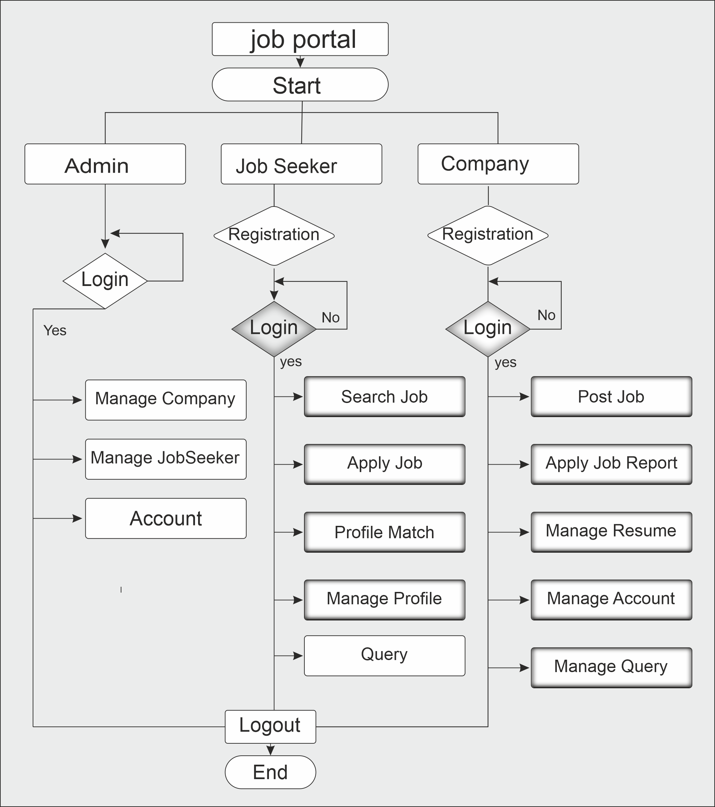
3. System Flow Chart

Slide 8
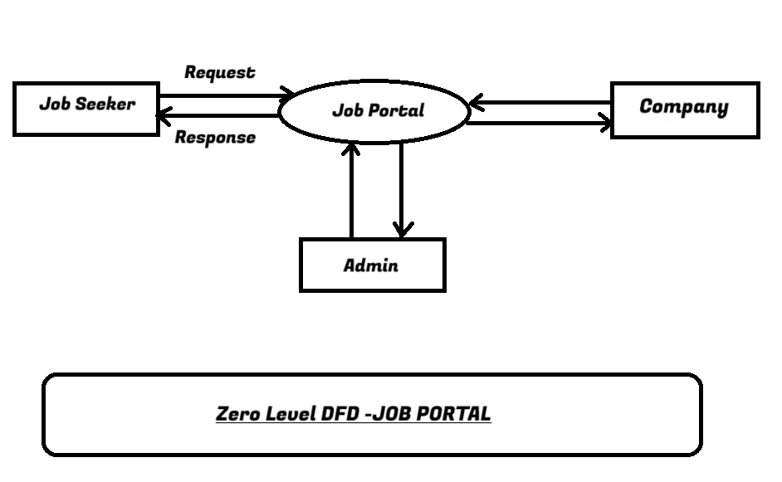
4. DFD / UML Diagram Context Level DFD :-

Slide 9
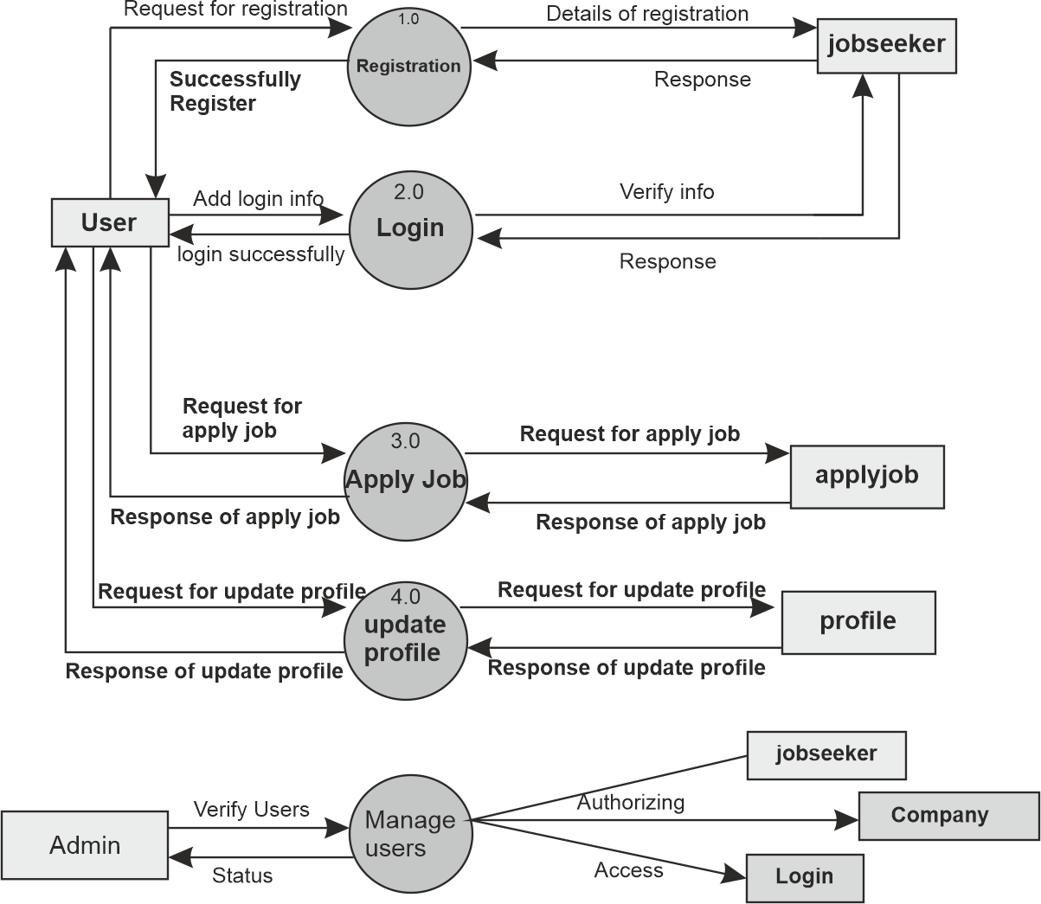
1st Level Admin & User DFD :

Slide 10
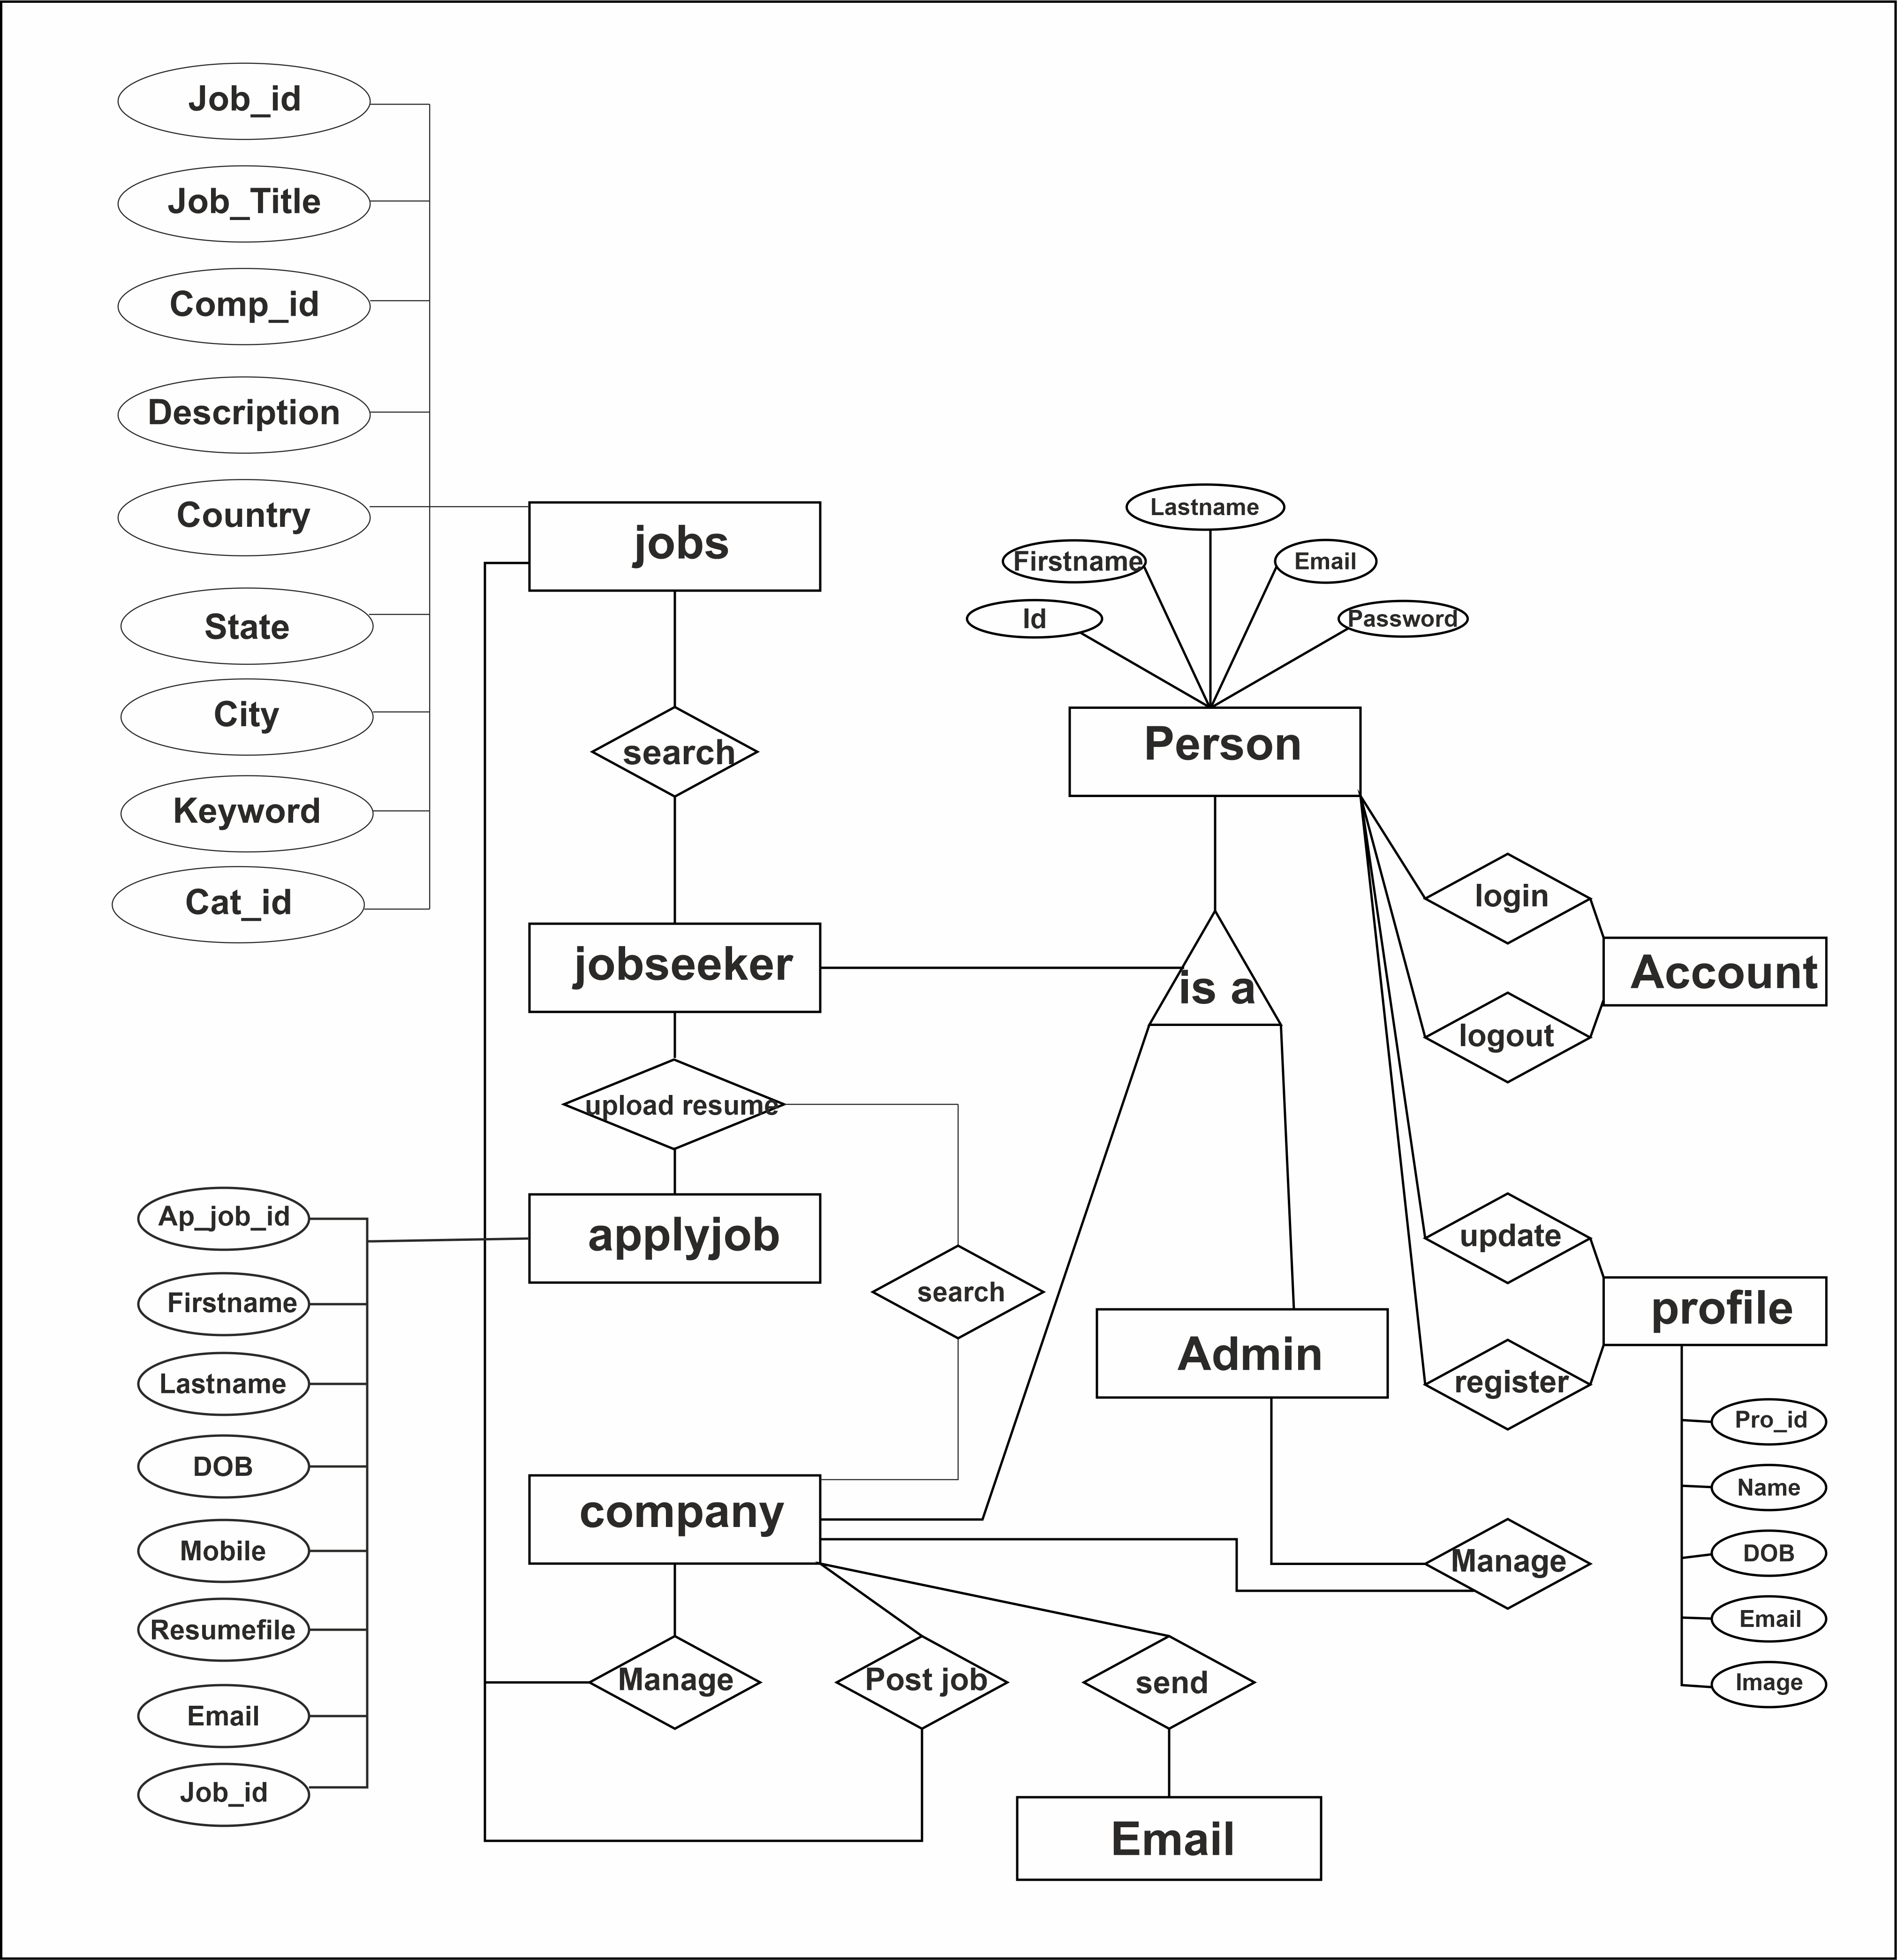
5. ER-Diagram

Slide 11
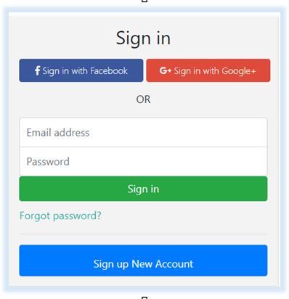
6. System Design Sign-in Page :

Slide 12
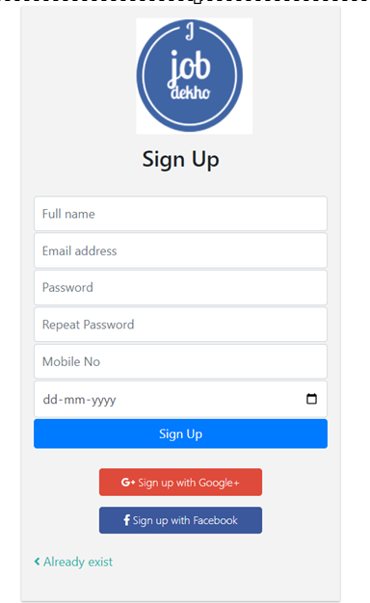
Sign-up Page :

Slide 13

Home Page :
This Page Is Job Seeker Side Home Page.
You Can Search Your Jobs Here And Also Can Apply The Job.

Slide 14

About Us Page :
This Page Is Job Seeker Side About Us Page.

Slide 15
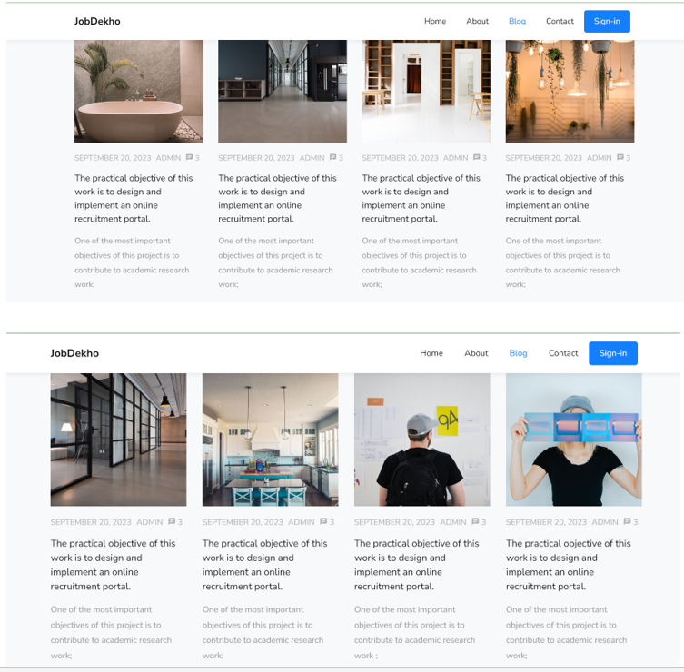
Blog Page :
This Page Is Job Seeker Side Blog Page.

Slide 16
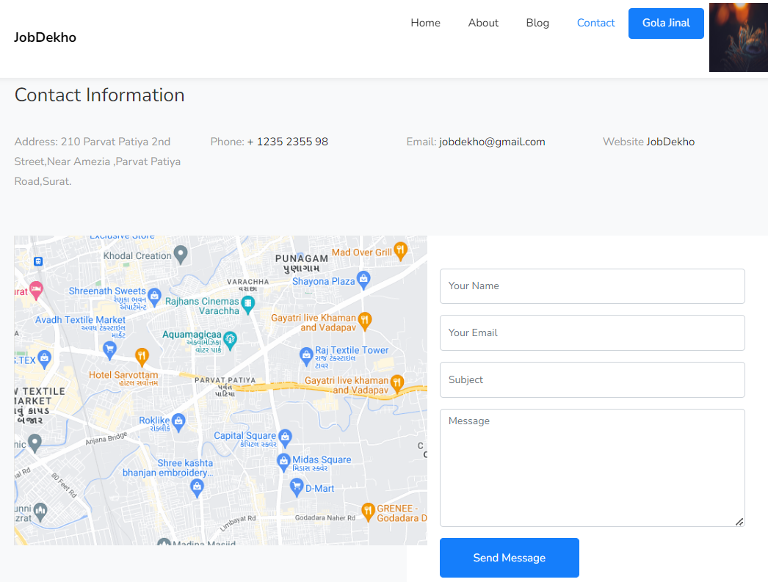
Contact Us Page :
This Page Is Job Seeker Side Contact Us Page.
You can Contact our portal and ask your question here.

Slide 17
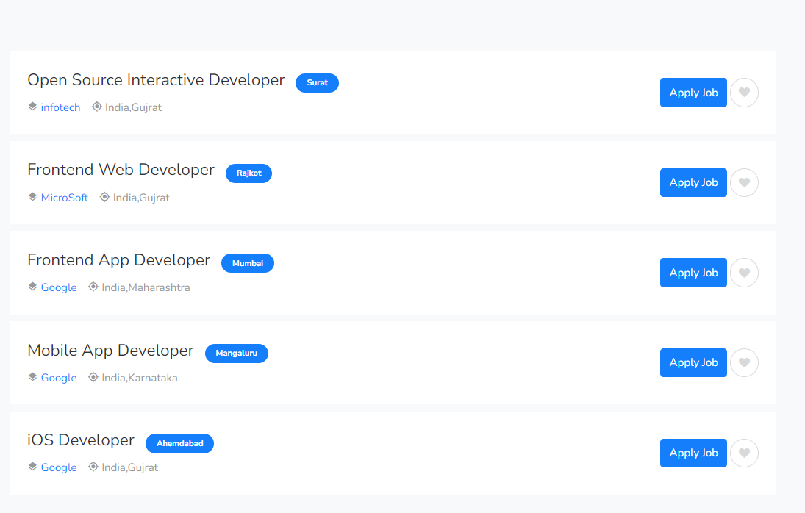
Job List :
This Is Our Job Listing You Can Apply Job Clicking On Apply Button.
You Can Only Apply If You Are Logged In.

Slide 18
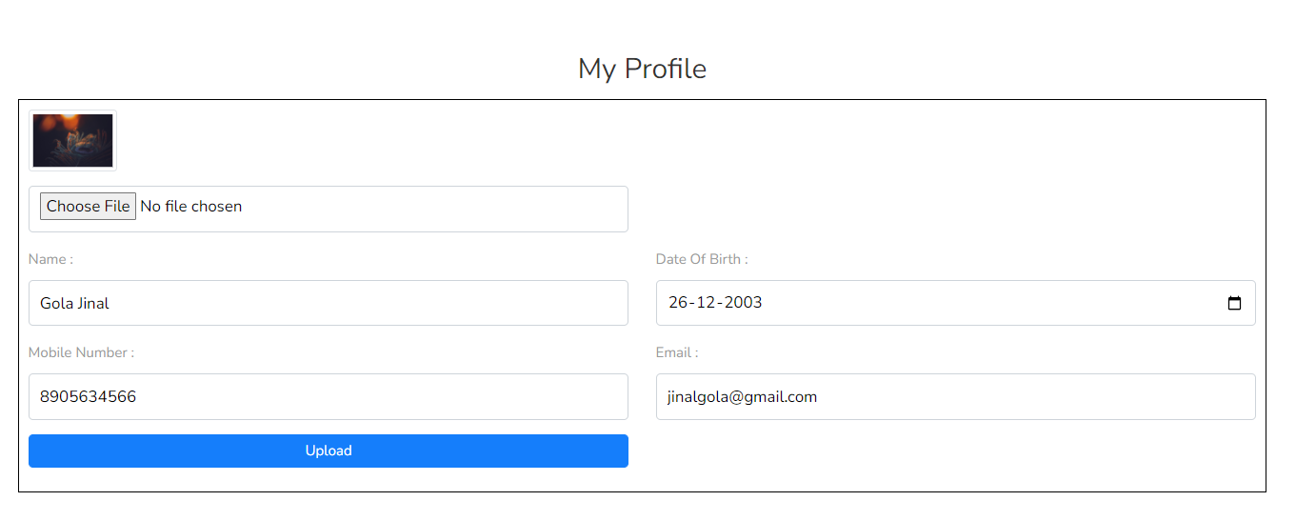
My Profile Page :
This is my profile page.
This page provides you update profile facility.
You can Update your Profile here.

Slide 19
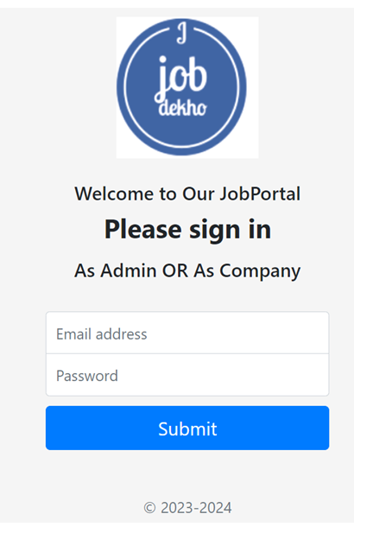
Admin-company Login Page :
This Our Login Page For Super Admin And Company Admin .

Slide 20
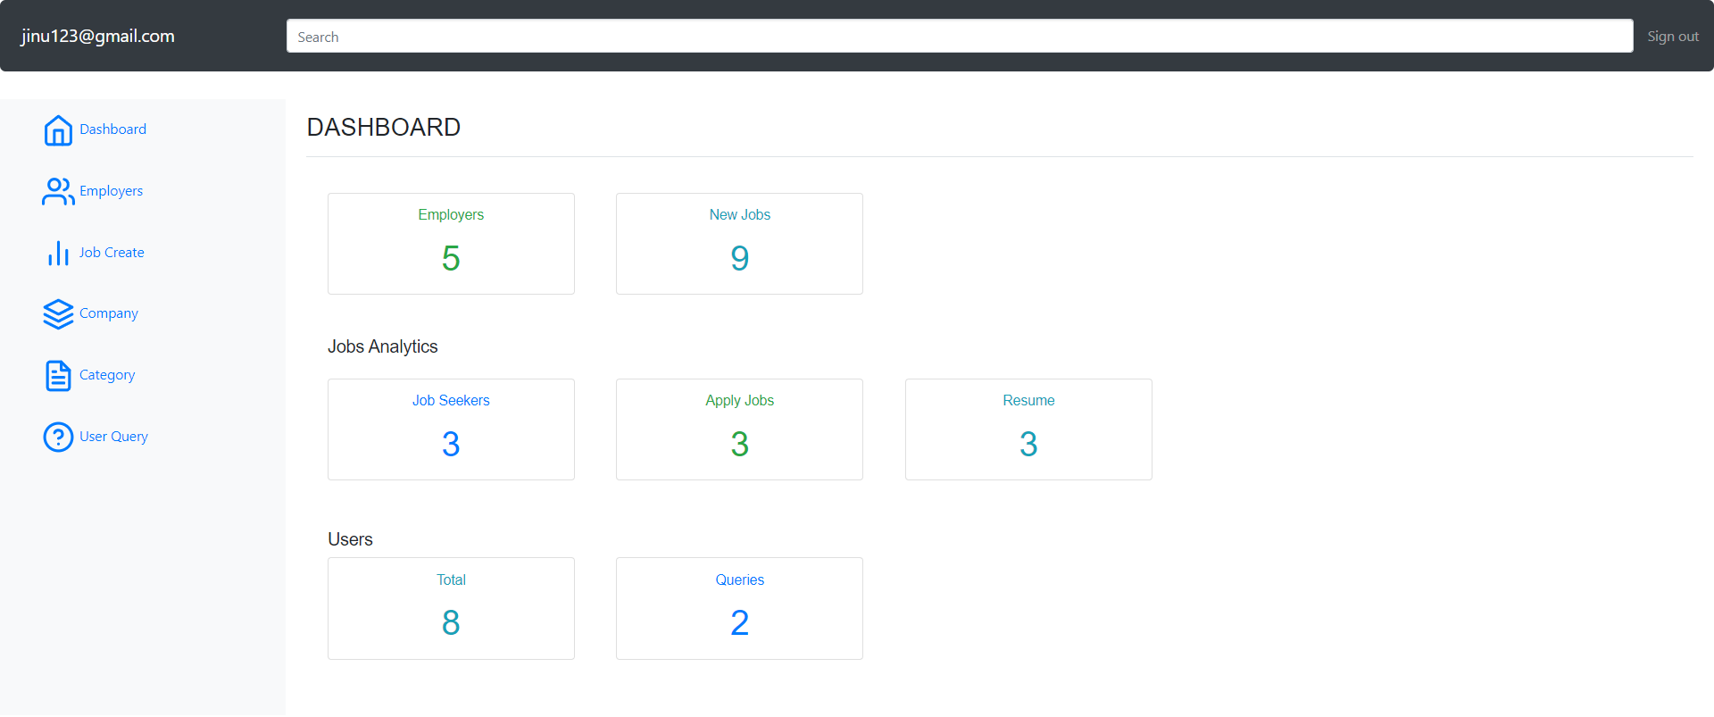
Dashboard Page :
This Our Dashboard Panel.
Discuss The Need For Regular Website Maintenance And Updates.

Slide 21
7. references
https://www.w3schools.com (For Common Query)
https://www.fontawesome.com (For Icons)
https://jquery.com (For jQuery)
https://www.naukari.com (For View Demo)
https://getbootstrap.com/docs/5.0/components ( For Code)
https://www.youtube.com/playlist?list=PLEtkoO2np9syrpHVx2jIIvP5HtiWHrfvW (For Code)

Slide 22

Thank you

